Slide 1
Comparison of Two Uniformity Tests
Can Erözer

Slide 2
Why is Uniformity Testing Essential?
Uniformity testing helps verify whether a process that should produce uniform random outcomes is behaving as expected.
This is critical in applications like:
Randomized Algorithms (sampling, hashing)
Cryptography (key generation)
Simulations (Monte Carlo methods)
…

Slide 3
What are the Challenges in Uniformity Tests?
The Goal: Detect Non-Uniformity with Few Samples
Uniformity testing asks:
“Can we detect whether a distribution over n elements is uniform, or ϵ-far from uniform, using as few samples as possible?”
This is hard because:
We Don't Know the Underlying Distribution
We only see the samples and not probabilities
Sample Size Should Be ≪ n

Slide 4
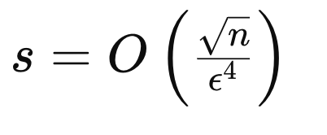
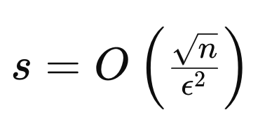
What are Some Uniformity Tests?
Collision-based Uniformity Test
The uniformity test we covered in class.
Paninski’s singleton-based test
The uniformity test proposed in Liam Paninski’s paper, “A Coincidence-Based Test for Uniformity Given Very Sparsely Sampled Discrete Data”.
Notes:
ADD NOTE HERE

Slide 5
What did I Compare?
To empirically compare these theoretical bounds, I implemented both tests and estimated the minimum number of samples s needed to reliably detect non-uniformity in each case.

Slide 6





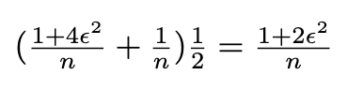
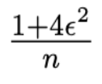
Collision-based Uniformity Test
If D is uniform:
If D is unknown:
YES
NO

Slide 7

If , output “D is not Uniform”
Else, output “D is Uniform”

Slide 8
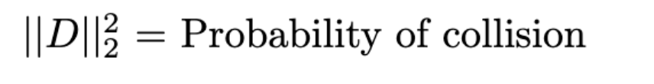


Direct Approach
Since the only thing that we know about D is its samples, we can’t directly compute:
We can keep drawing pairs and see the number of collisions you get in them:
But this requires,
And, we want to do this ≪ n

Slide 9
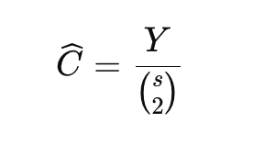
Better Algorithm
Draw s samples and use the number of collisions on all pairs:
Defining the test statistic:

Slide 10
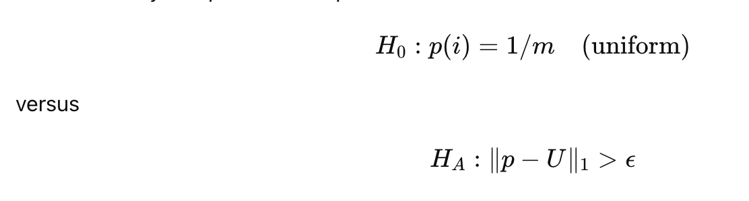

Paninski’s Singleton-Based Test
Defining the test statistic:

Slide 11
Paninski’s Singleton-Based Test
Main Idea:
Under H0​ (uniform), K1​ will be high
Under HA​ (non-uniform), K1​ will drop because collisions happen more.

Slide 12
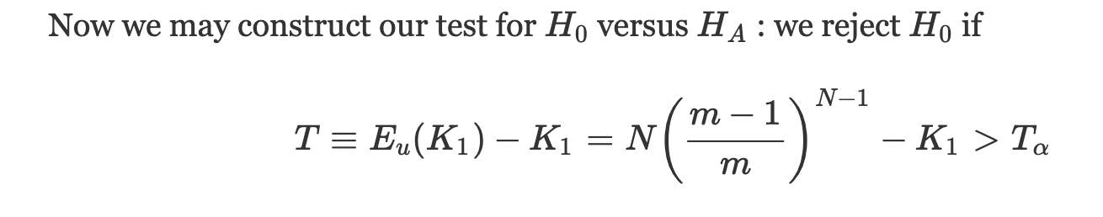
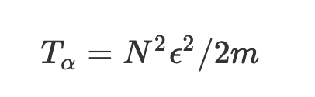
The algorithm
where

Slide 13
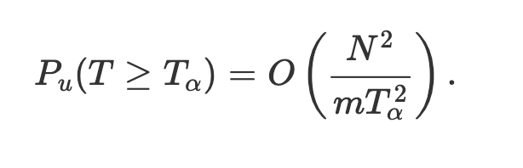
Using the Chebyshev’s Inequality:

Slide 14
My Methodology in Comparing s in Two Tests
I created three different subroutines for generating random samples:
A subroutine generating samples from the uniform distribution on [n].
A subroutine generating samples from some distribution on [n] that is ϵ–far from uniform in total variation distance and minimizes the expected number of collisions. (Dfar_1)
A subroutine generating samples from some distribution on [n] that is ϵ–far from uniform in total variation and no test reliably distinguishes H0 from HA. (Dfar_2)

Slide 15
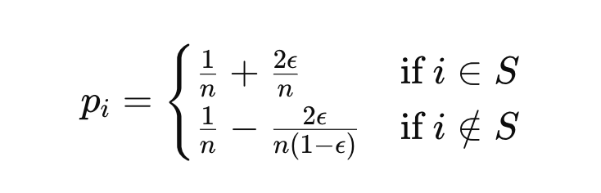
Second Subroutine
Construction for Dfar_1:
Partition [n] into two groups:
A set S of size ϵn,
The complement [n]∖S of size (1−ϵ)n.
This ensures that the total variation distance from uniform is at least ϵ, and by spreading the perturbation thinly across many elements, we minimize the expectation.

Slide 16
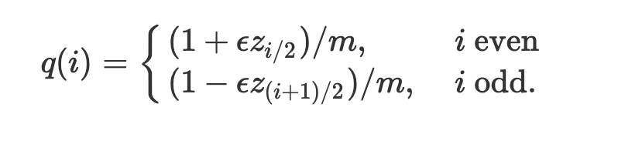
Third Subroutine
The third subroutine is suggested by Paninski:
The ϵ-perturbed Bernoulli-hypercube distribution
Assume that m is even. We choose q randomly according to the following distribution μ(q) : choose m/2 independent Bernoulli RVs zj∈{−1,1} (i.e., z samples uniformly from the corners of the m/2-dimensional hypercube).
Given {zj}, set

Slide 17
Why these Subroutines?
In uniformity testing, we want to distinguish the uniform distribution from any distribution that is ϵ-far in total variation distance.
But since there are infinitely many such distributions, I choose representative hard cases, Dfar​_1 and Dfar_2, simulate realistic and challenging conditions for testing.

Slide 18
Procedure in Finding s
I used a repeated (s, t)-thresholding procedure
For a given candidate s and each of U and Dfar, collect s samples and write down the number of collisions you observed. Repeat this a sufficiently large number of times, at least ≫ 1/δ, to see how this number is distributed for U and Dfar.
I selected a threshold t so that at least a 1 − δ fraction of collision numbers I observed for U are below the threshold and at least a 1 − δ fraction of collision numbers I observed for Dfar are above the threshold.
If so, I used this s and t.
If not, I increased s—multiplied it by 1.1—and tried again.
I did this for both Dfar (U vs. Dfar1 and U vs. Dfar2)

Slide 19
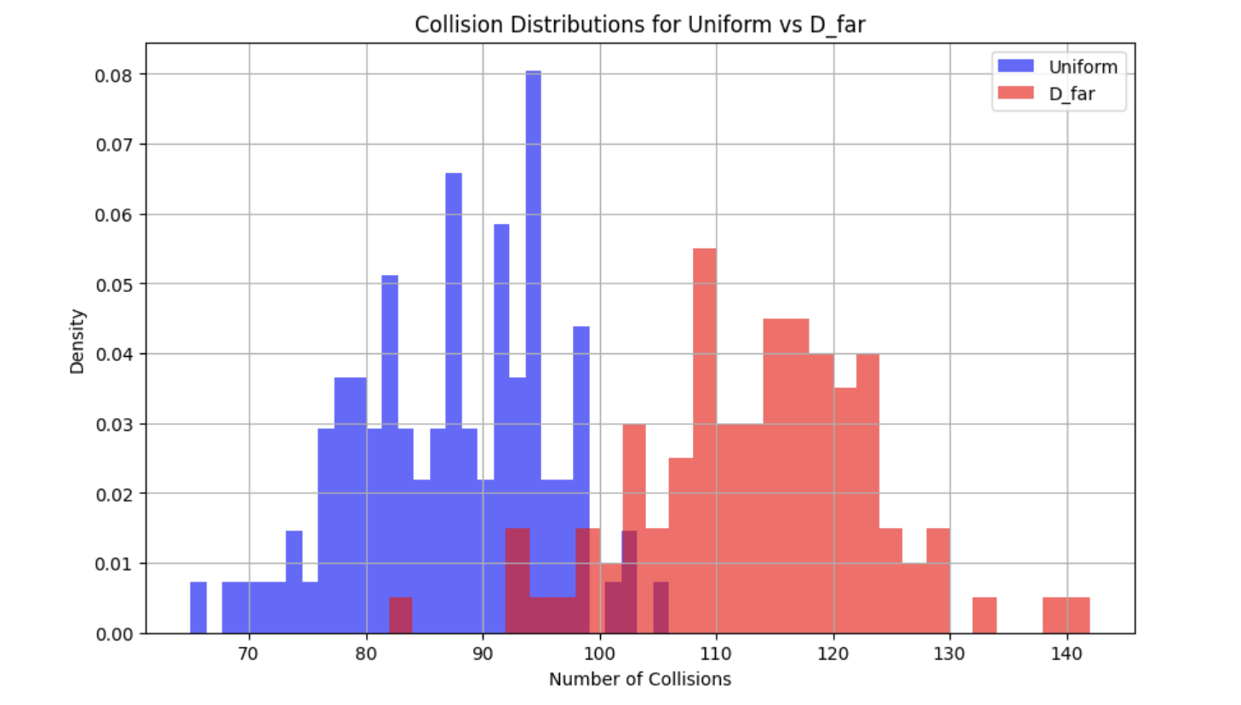
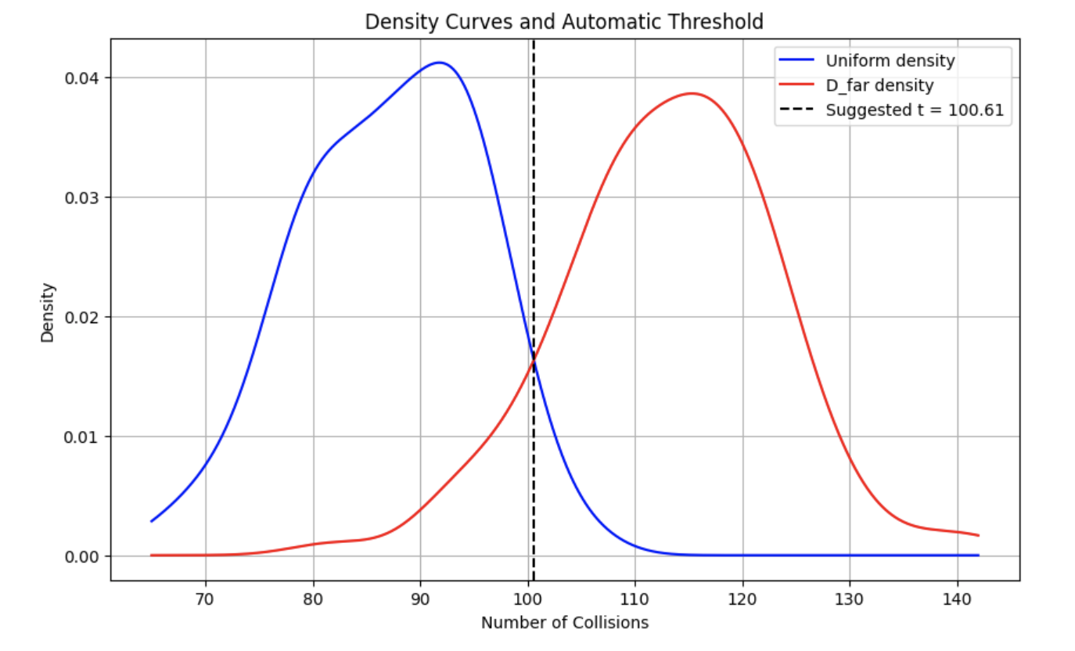
Visualization of my Procedure

Slide 20
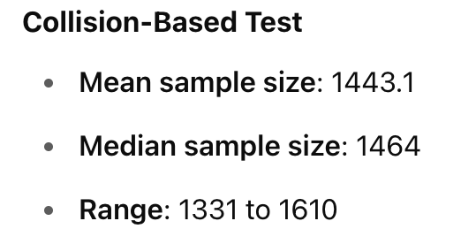
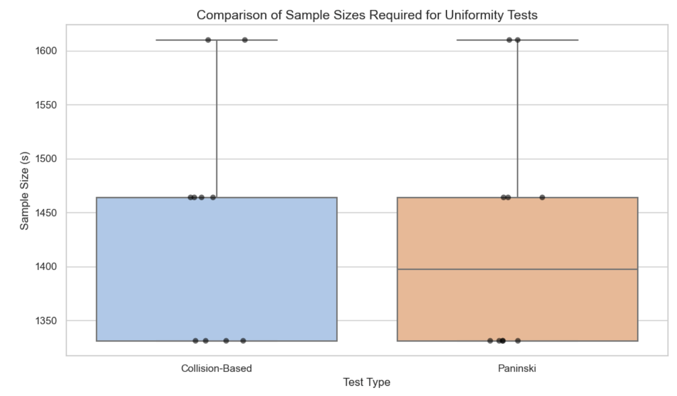
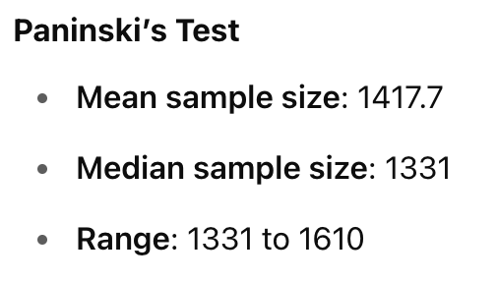
Empirical Results I
For n=10,000, epsilon=0.2, delta=0.1

Slide 21
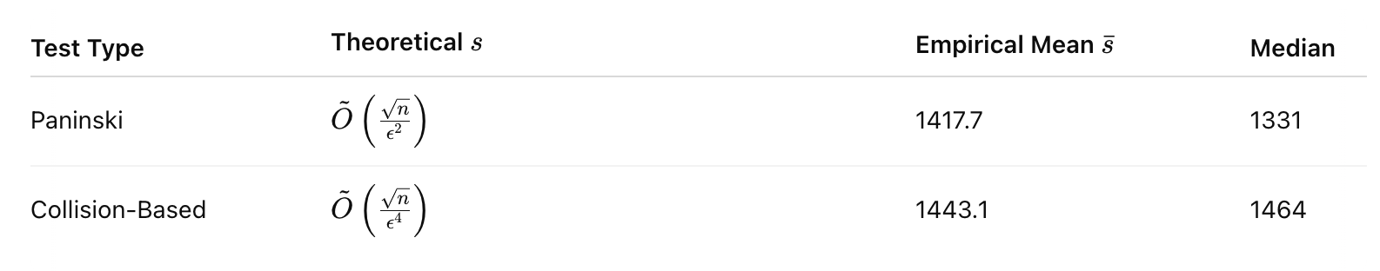
Empirical Results I
Observation: Paninski's test requires fewer samples.

Slide 22
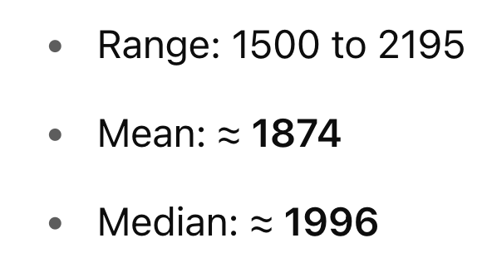
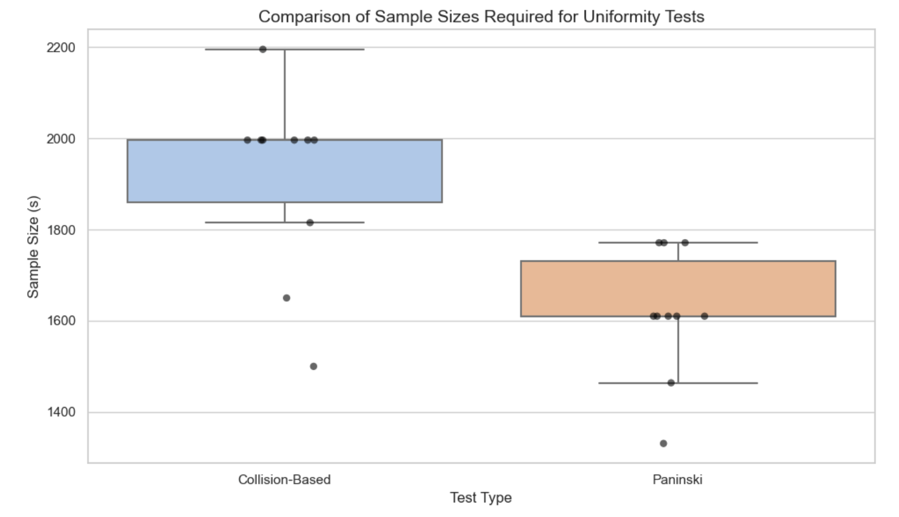
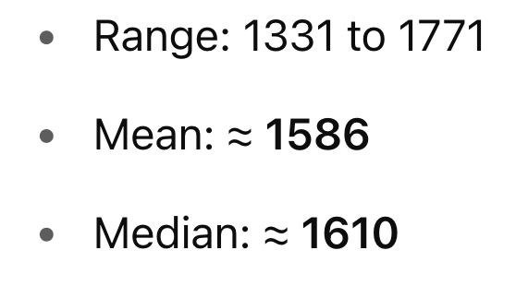
Empirical Results II
Collision-based:
For n=10,000, epsilon=0.3, delta=0.3
Paninski’s:

Slide 23
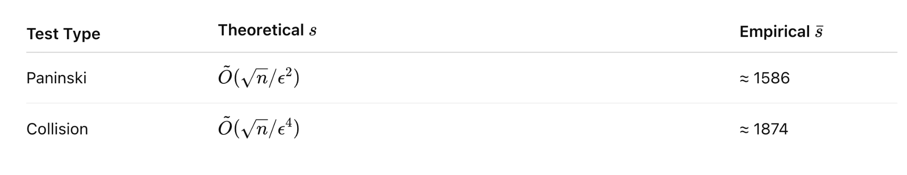
Empirical Results II
Observation: Paninski's test requires fewer samples.

Slide 24
Next Steps
Paninski's test uses the number of singletons in a sample as a statistic to test for uniformity.
=> Under the uniform distribution, we expect many singletons, whereas under ϵ-far alternatives, singletons decrease.
In Homework 2, we studied heavy buckets — bins with >= 200 elements in it.

Slide 25

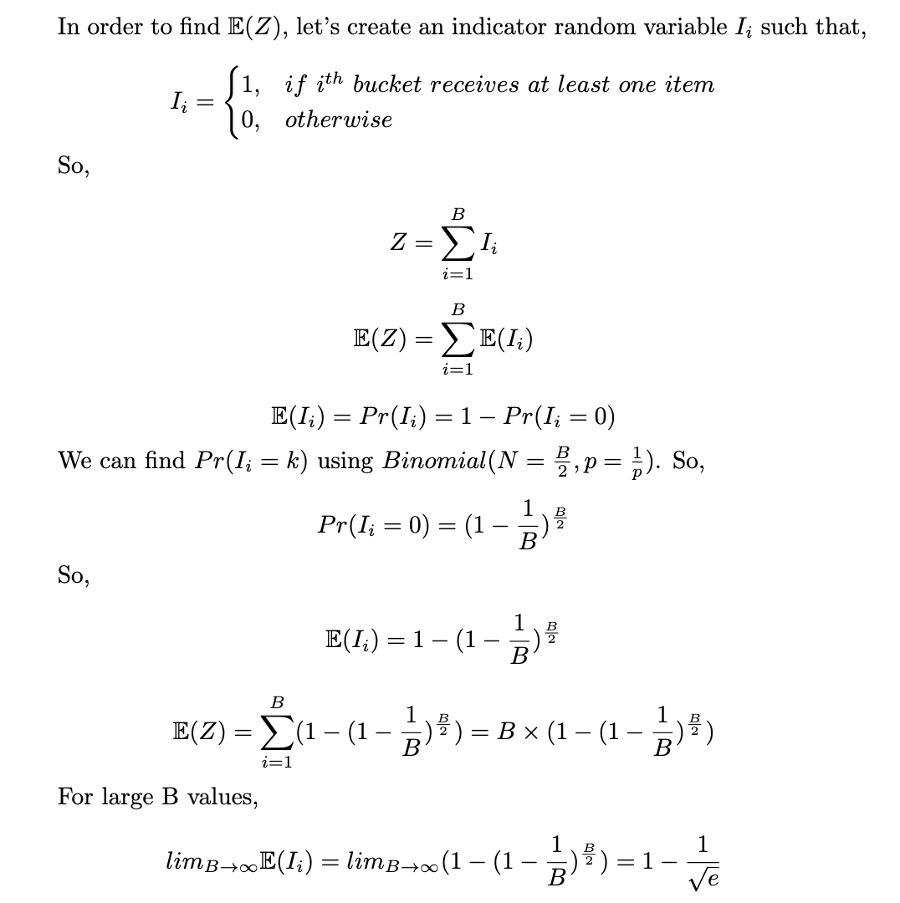
Let Z be the number of buckets that received at least one item.
So, would give me the fraction of heavy buckets.

Slide 26
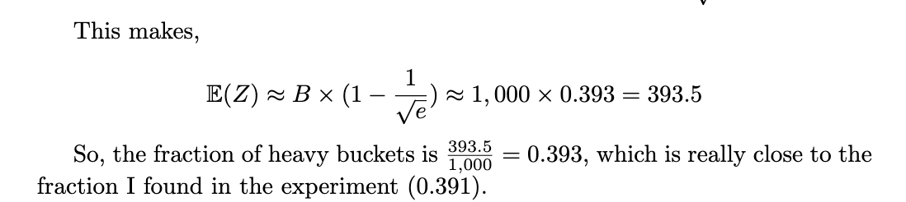

Slide 27
Thanks! Questions?

